Slide 1
Diffusion Map and Spectral Clustering
Higher Understanding With Lower Dimensions
Great Lakes Bioinformatics Tutorial
May 20th 2019

Slide 2
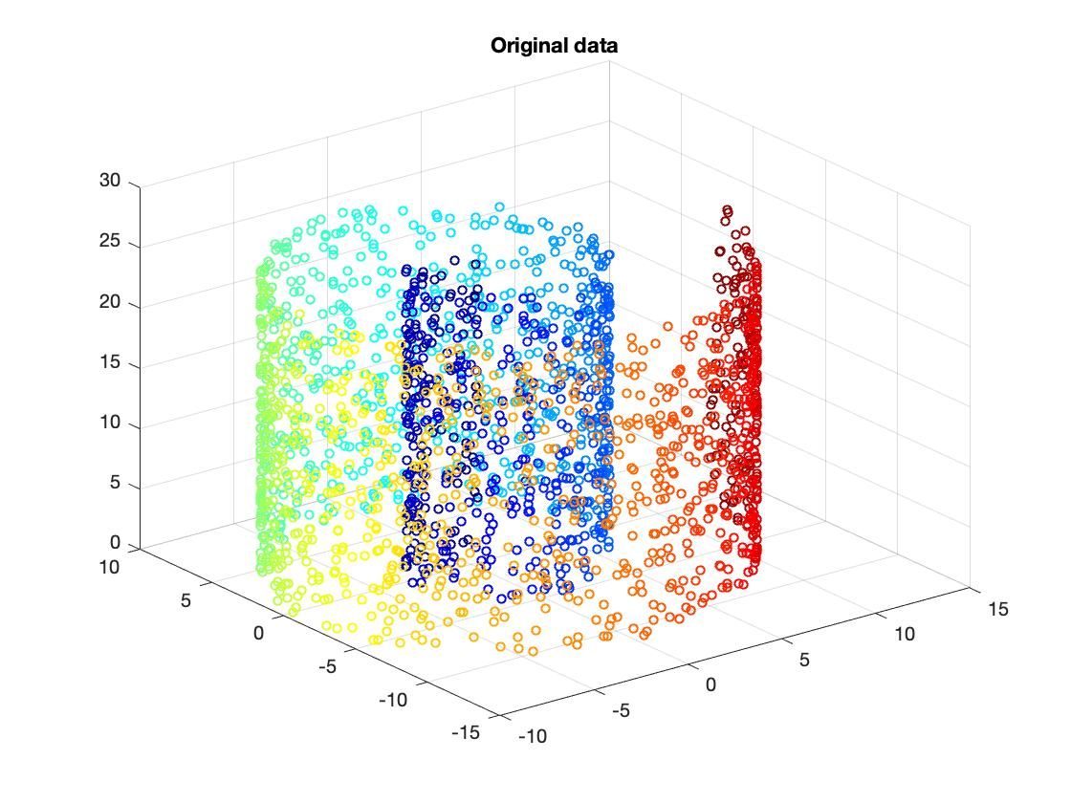
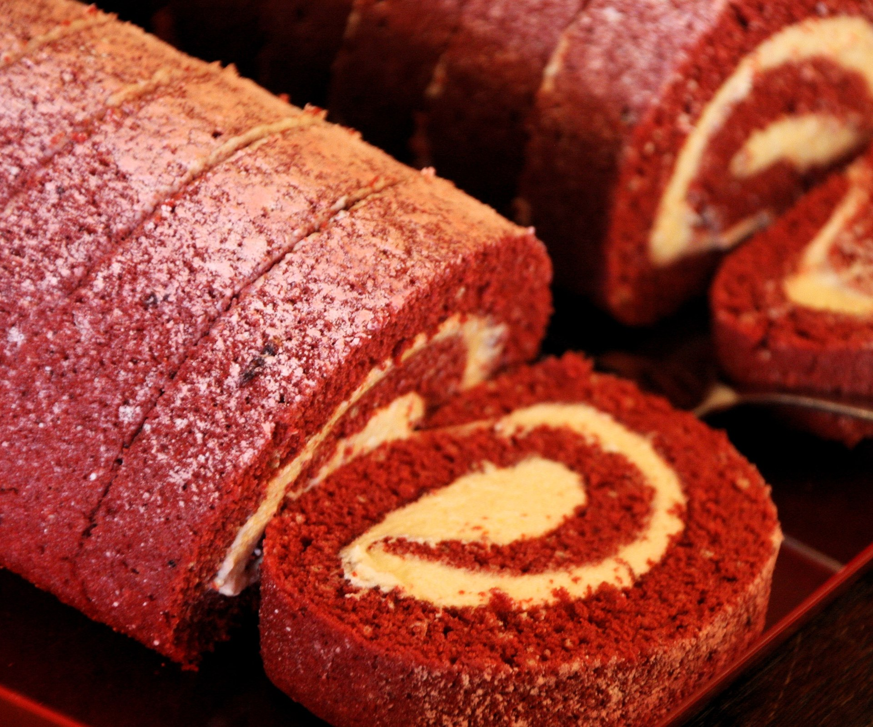
Why diffusion maps?
“Swiss roll” R code included in tutorial!

Slide 3
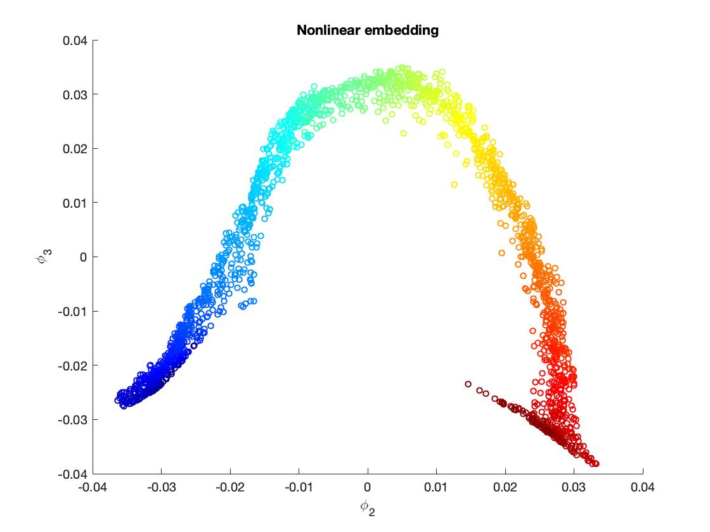
Why diffusion maps?
“Swiss roll” R code included in tutorial!

Slide 4
Benefits of diffusion maps
Diffusion maps provide a low-dimensional representation even when the underlying manifold is non-linear

Slide 5
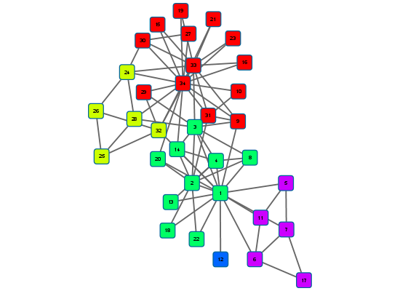
Benefits of diffusion maps
Easy to apply spectral clustering (graph clustering)

Slide 6
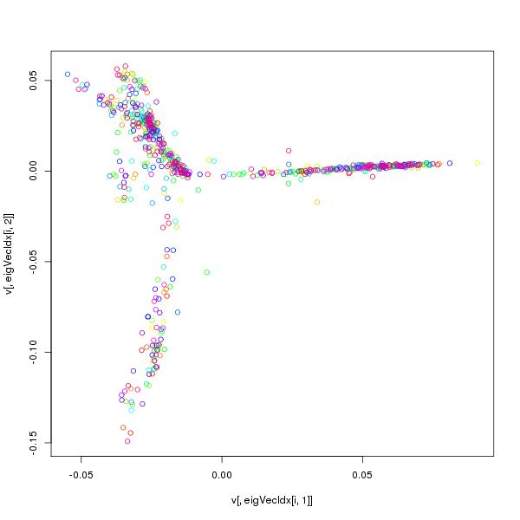
Benefits of diffusion maps
Many applications
scRNA-seq trajectories
Hi-C Data

Slide 7
Diffusion maps: step by step
1. Define a similarity matrix

Slide 8
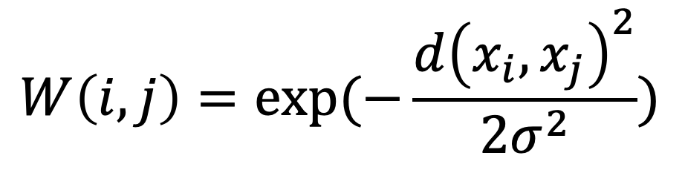
Diffusion maps: step by step
2. Compute a kernel from similarity matrix (e.g. Gaussian)
$$W\left(i,j\right)=exp⁡(−\frac{d{\left(x_{i},x_{j}\right)}^{2}}{2σ^{2}})$$
A kernel defines the local geometry of the data. It:
Is symmetric
Is positivity preserving
Represents the connectivity

Slide 9
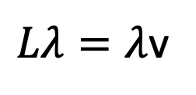
Diffusion maps: step by step
3. Build a graph Laplacian
1
N
1
N
1
Gaussian kernel (W)
Laplacian (L)
In tutorial: Symmetric normalized Laplacian
N
N
$Lλ=λ$v
The smallest eigenvalue of L is 0 and its corresponding eigenvector is all 1s
L has n non-negative eigenvalues

Slide 10
Connected components
A subgraph where there is path from one node to another
The number of connected components is inherently tied to the Laplacian matrix
Subsequent eigenvalues also related to connectivity
B
Two connected components
G
C
F
A
H
E
D
Connected component: A subgraph spanning a vertex subset where every vertex can be “reached” from another vertex
Slide from Sushmita Roy

Slide 11
Diffusion maps: step by step
4. Obtain a non-linear embedding. For this we need the eigenvectors associated with the top eigenvalues of the Laplacian (previous step).

Slide 12
Diffusion maps: step by step
4. Obtain a non-linear embedding. For this we need the eigenvectors associated with the top eigenvalues of the Laplacian (previous step).
1
N
1
N
1
k
1
Gaussian kernel (W)
1
Laplacian (L)
1
First k eigen vectors
N
N
N

Slide 13
Spectral Clustering: One extra Ssep!
1
N
1
N
1
k
k
1
Gaussian kernel (W)
1
Laplacian (L)
1
First k eigen vectors
k clusters
…
N
N
Represent each node as the k-dimensional vector
Cluster nodes based on k-means clustering

Slide 14
Recall the Zachary karate club study
Example by Sushmita Roy

Slide 15
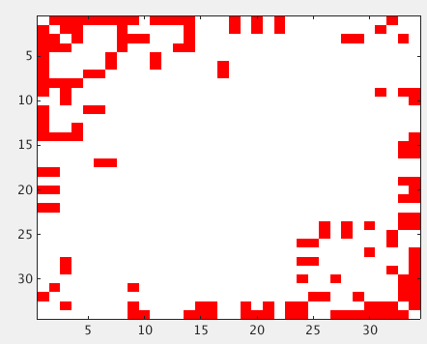
Adjacency matrix of Zachary Karate club study

Slide 16
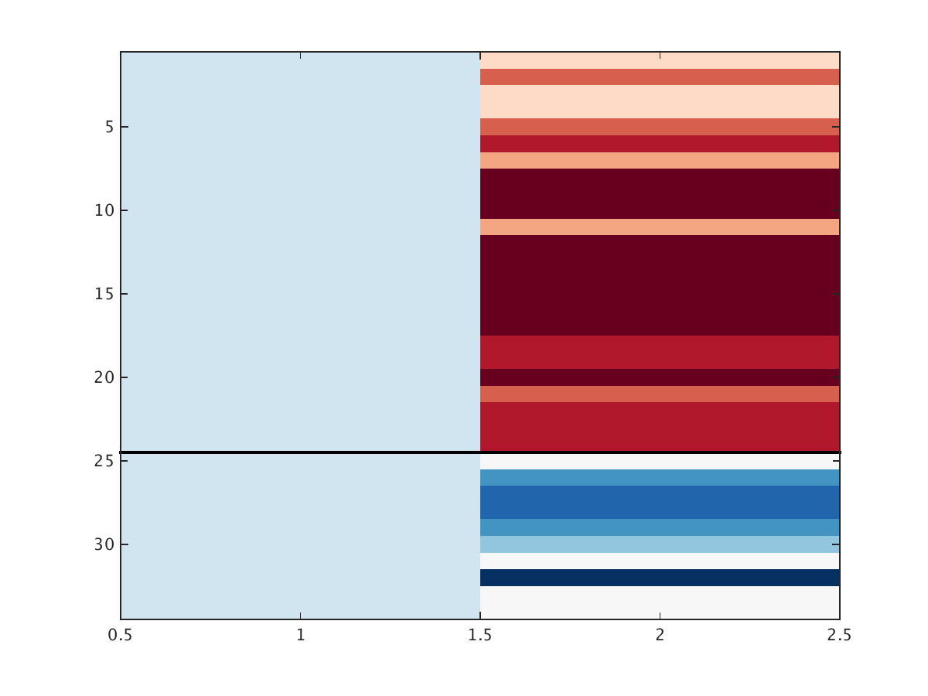
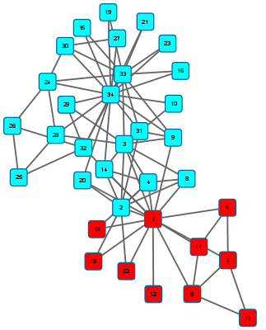
Clusters depicted on the graph

Slide 17
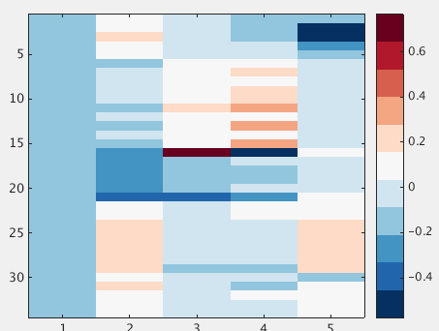
First five eigen vectors of Zachary Karate club data

Slide 18
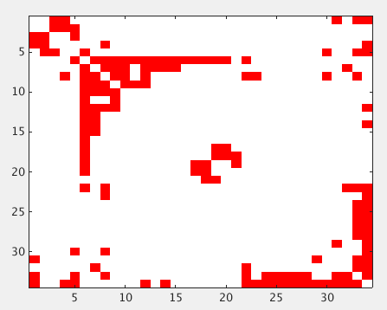
Reordered matrix post clustering

Slide 19
ZKC graph clustered into k=5 clusters

Slide 20
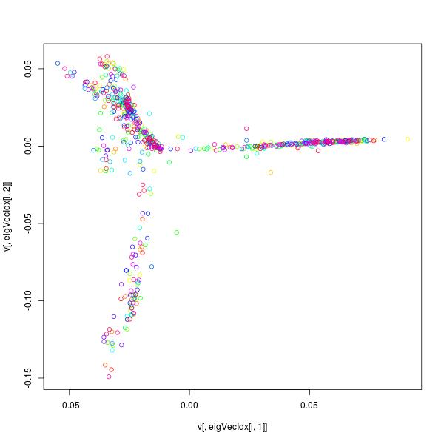
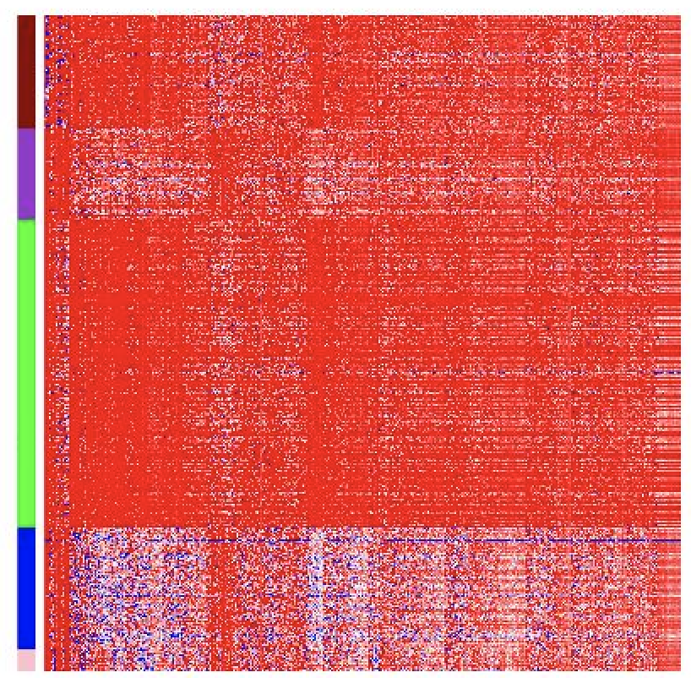
Tutorial: peripheral blood mononuclear cell scRNA-seq
Diffusion Map
Gene expression
Gene
Cells
Clusters of cells after spectral clustering (k=5)
Cells projected onto a low dimensional embedding

